Slide 1
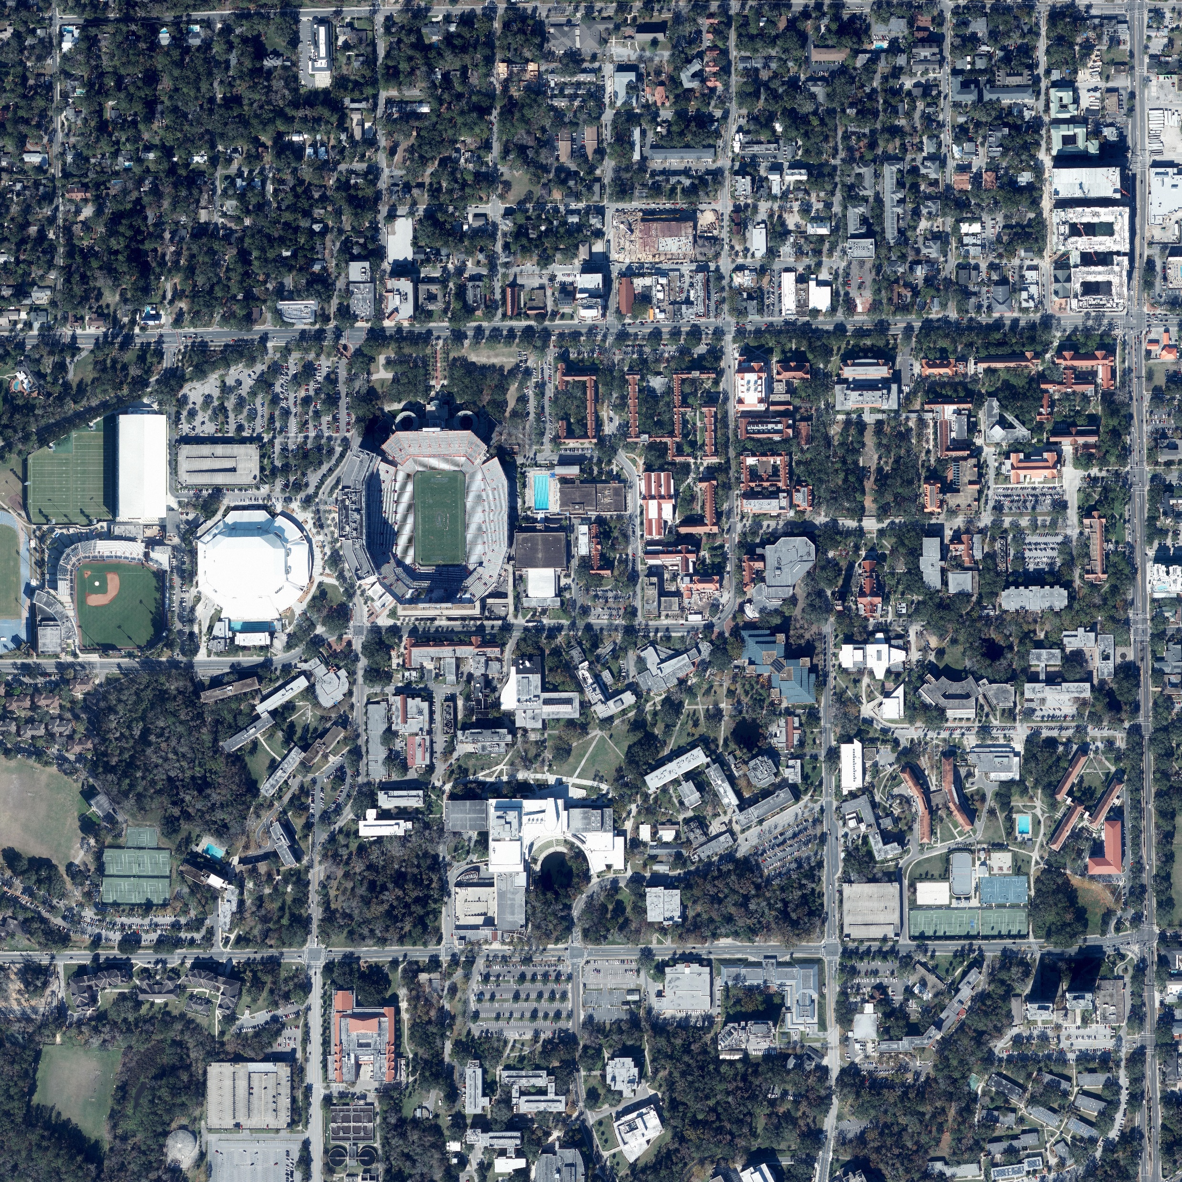

Shadow-based georeferencing with 3D models
Aerial photo (2017)
LiDAR (2001)
= ?
REF: Troccoli and Allen, 2007

